Slide 1
Data Communications and Networking
Chapter 7
Error Control and Data Link Control
References:
Book Chapter 6 and 7
Data and Computer Communications, 8th edition, by William Stallings

Slide 2
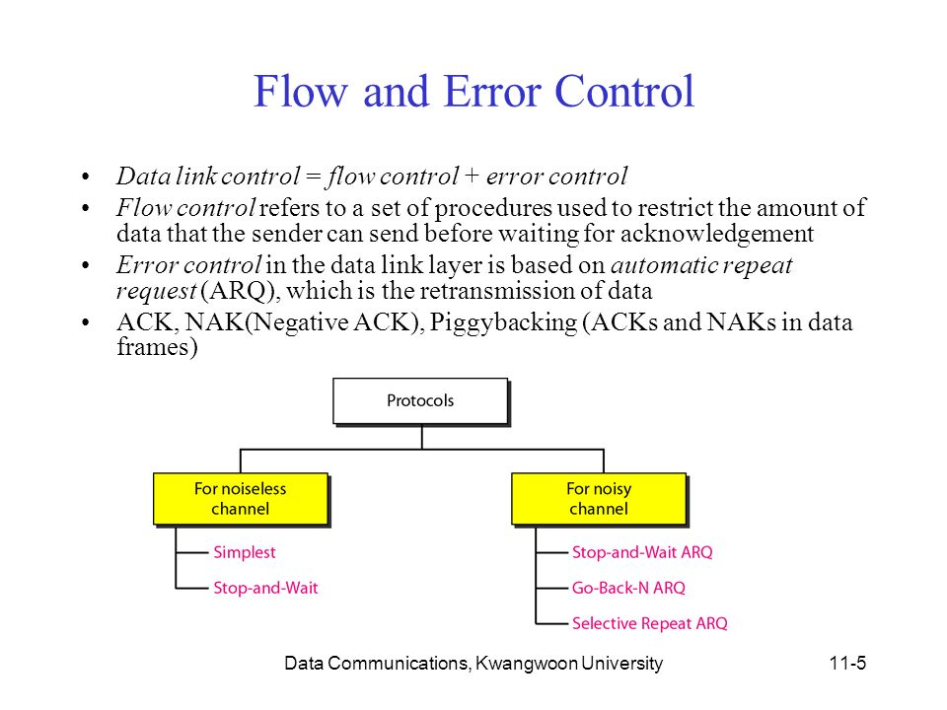

Slide 3
Data Link Layer
Objective:
  Achieving reliable communication between two adjacent machines
Design Issues:
  Framing: data are sent in blocks called frames, the beginning and end of each frame must be recognized by the receiver.
  Error control: bit errors introduced by the transmission system should be detected and/or corrected.
  Flow control: the sending station must not send frames at a rate faster than the receiving station can absorb them.
  Addressing: on a multipoint line, such as a LAN, the identity of the two stations involved in a transmission must be specified.
  Transmit control information and data on the same line

Slide 4
Framing
Large block of data may be broken up into small frames at the source because:
  limited buffer size at the receiver
  A larger block of data has higher probability of error
    With smaller frames, errors are detected sooner, and only a smaller amount of data needs to be retransmitted
  On a shared medium, such as Ethernet and Wireless LAN, small frame size can prevent one station from occupying medium for long periods

Slide 5
Framing
Need to indicate the start and end of a block of data
Use preamble (e.g., flag byte) and postamble
If the receiver ever loses synchronization, it can just search for the flag byte.
Frame: preamble + control info + data + postamble
Problem: it is possible that the flag byte’s bit pattern occur in the data
Two popular solutions:
  Byte stuffing
    The sender inserts a special byte (e.g., ESC) just before each “accidental” flag byte in the data (like in C language, “ is replaced with \”).
    The receiver’s link layer removes this special byte before the data are given to the network layer.
  Bit stuffing: each frame starts with a flag byte “01111110”.
    Whenever the sender encounters five consecutive 1s in the data, it automatically stuffs a 0 bit into the outgoing bit stream.
    When the receiver sees five consecutive incoming 1 bits, followed by a 0 bit, it automatically deletes the 0 bit.

Slide 6
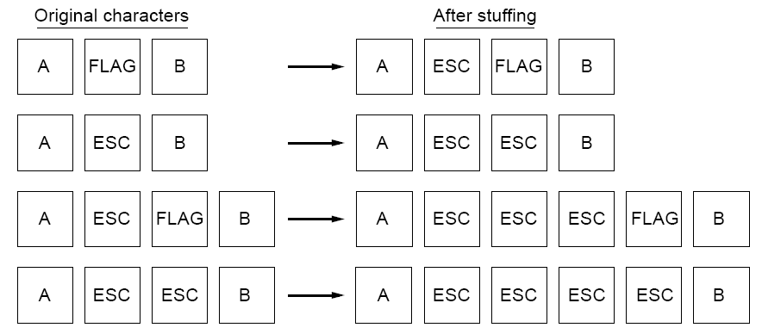
Byte Stuffing
Four examples of byte sequences before and after byte stuffing

Slide 7
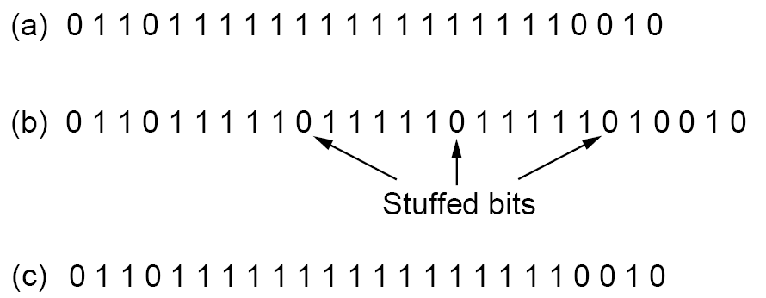
Bit Stuffing
Bit stuffing:
The original data.
The data as they appear on the line.
The data as they are stored in the receiver’s memory after destuffing.

Slide 8
Error Detection: Types of Error
An error occurs when a bit is altered between transmission and reception
Single bit errors
  One bit is altered
  Adjacent bits are not affected
  Can occur in the presence of white noise (thermal noise)
Burst errors
  A cluster of bits with Length B
  the first and the last and a number of intermediate bits in error (not necessarily all the bits in the cluster suffer an error)
  More common and more difficult to deal with
  Can be caused by impulse noise

Slide 9
Parity Check
Append a parity bit to the end of a block of data
Value of parity bit is such that the new data has even (even parity) or odd (odd parity) number of ones
  E.g., original data 1110001 -> 11100011 (odd parity)
Even number of bit errors goes undetected
  E.g., 11100011 -> 11010011 (undetected!)

Slide 10
Cyclic Redundancy Check
For a block of k bits, transmitter generates an (n-k)-bit sequence called Frame Check Sequence (FCS)
The resulting frame consisting of n bits is exactly divisible by some predetermined number.
Receiver divides the incoming frame by the predetermined number:
  If no remainder, assume no error

Slide 11
Cyclic Redundancy Check
Modulo 2 arithmetic
  Binary addition with no carries
  Binary subtraction with no carries
  The same as XOR operation
1111 + 1010 = 0101
1111 − 0101 = 1010
1010 + 1010 = 0000

Slide 12
Cyclic Redundancy Check
Define:
  T = n-bit frame to be transmitted
  D = k-bit block of data: the first k bits of T
  F = (n-k)-bit FCS: the last (n-k) bits of T
  P = pattern of (n-k+1) bits: the predetermined divisor
T = 2^{n-k}D + F
We want T/P to have no remainder.
Problem: Given D and P, how to calculate F ?

Slide 13
Flow Control
Ensuring the sending entity does not overwhelm the receiving entity
  Preventing buffer overflow
Transmission time
  Time taken to emit all bits into medium at the sender’s side
  Determined by the data rate
Propagation time
  Time for a bit to traverse the link and reach the destination
  Determined by the transmission distance
We first assume error-free transmission.

Slide 14
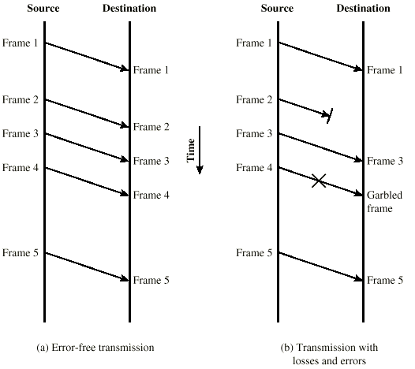
Model of Frame Transmission

Slide 15
Stop-and-Wait Flow Control
Source transmits a frame.
Destination receives the frame, and replies with a small frame called acknowledgement (ACK).
Source waits for the ACK before sending the next frame.
  This is the core of the protocol !
Destination can stop the flow by not sending ACK (e.g., if the destination is busy …).

Slide 16
Performance of Stop-and-Wait
Assumptions
  Transmission time of the data frame is 1
  Transmission time of the ACK frame is 0
  Propagation time is a
    a is the ratio of propagation time over transmission time
  Error-free transmission
The channel utilization ratio is 1/(1+2a)
  In a time period of 1+2a, the transmitter is only busy with 1 unit of time.
It is not efficient for long haul transmission and high speed transmission.
  Another type of protocol called “sliding-window” is designed for this situation.

Slide 17
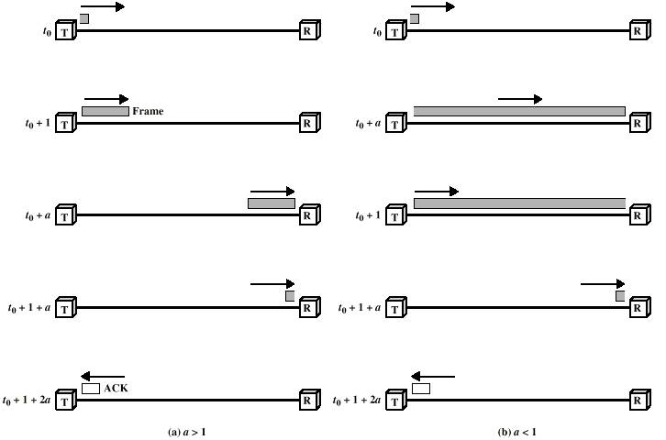
Stop-and-Wait Link Utilization

Slide 18
Sliding-Window Flow Control
Idea: allow multiple frames to transmit
  Receiver has a buffer of W frames
  Transmitter can send up to W frames without receiving ACK
Each frame needs to be numbered: sequence number is included in the frame header
  Sequence number is bounded by the length of “sequence number field” in the header, e.g., k bits
    Frames are numbered modulo 2^{k}
ACK includes the sequence number of the next expected frame by the receiver

Slide 19
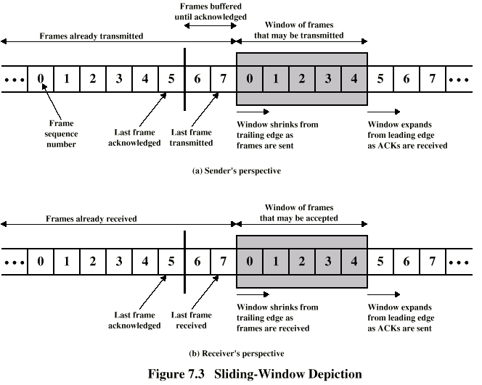
Sliding-Window Diagram
Need to buffer them in case of retransmission
Notes:
Assume 3-bit sequence number is used. Frames are numbered sequentially from 0 through 7.
In Fig.(a), each time a frame is sent, the shaded window shrinks; each time an ACK is received, the shaded window grows.

Slide 20
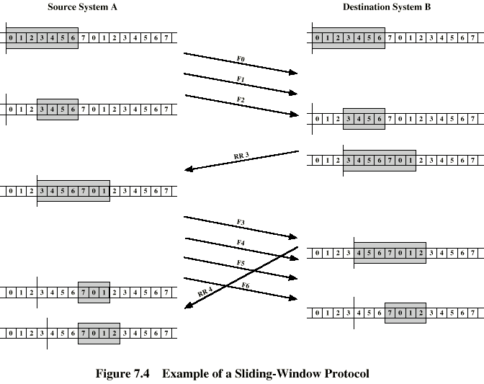
Example Sliding-Window
RR3 means the receiver has received all frames up to frame 2 and is ready to receive frame 3.
Have been delivered to upper layer
More spaces for future frames
Notes:
It is not necessary to acknowledge every frame.

Slide 21
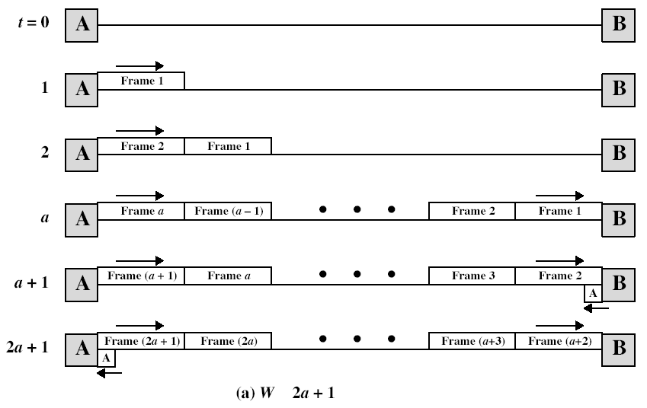
Performance of Sliding-Window
≥

Slide 22
Error Control
Error control: detection and correction of errors
We consider two types of errors:
  Lost frames
    The receiver cannot recognize that this is a frame.
  Damaged frames
    The receiver can recognize the frame, but some bits are in error.
Two approaches for error control
  ARQ: automatic repeat request, based on some or all of the following ingredients:
    Error detection
    Positive acknowledgment
    Retransmission after timeout
    Negative acknowledgement and retransmission
  FEC: forward error correction

Slide 23
Automatic Repeat Request (ARQ)
The effect of ARQ is to turn an unreliable data link into a reliable one.
Three versions of ARQ:
  Stop-and-wait
  Go-back-N
  Selective-reject (or, selective repeat)

Slide 24
Stop-and-Wait ARQ
Based on stop-and-wait flow control
The source station is equipped with a timer.
Source transmits a single frame, and waits for an ACK
If the frame is lost…
  The timer eventually fires, and the source retransmits the frame.
If receiver receives a damaged frame, discard it
  The timer eventually fires, and the source retransmits the frame.
If everything goes right, but the ACK is damaged or lost, the source will not recognize it
  The timer eventually fires, the source will retransmit the frame
  Receiver gets two copies of the same frame!
  Solution: use sequence numbers, 1 bit is enough, i.e., frame0 and frame1, ACK0 and ACK1

Slide 25
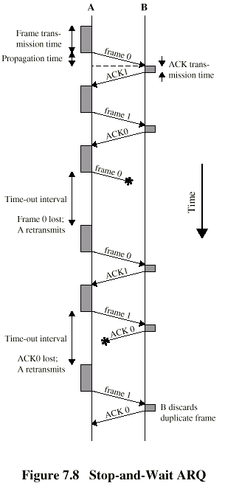
Stop-and-Wait
Diagram
Simple, but inefficient for long distance and high speed applications.
We can use sliding-window technique to improve the efficiency.

Slide 26
Go-Back-N ARQ
Based on sliding-window flow control
Use window size to control the number of unacknowledged frames outstanding
If no error, the destination will send ACK as usual with next frame expected (positive ACK, RR: receive ready)
If error, the destination will reply with rejection (negative ACK, REJ: reject)
  Receiver discards that frame and all future frames, until the erroneous frame is received correctly.
  Source must go back and retransmit that frame and all succeeding frames that were transmitted in the interim.
  This makes the receiver simple, but decreases the efficiency

Slide 27
Go-Back-N: Damaged Frame
Suppose A is sending frames to B. After each transmission, A sets a timer for the frame.
In Go-Back-N ARQ, if the receiver detects error in frame i
  Receiver discards the frame, and sends REJ-i
  Source gets REJ-i
  Source retransmits frame i and all subsequent frames

Slide 28
Go-Back-N: Lost Frame (1)
Assume receiver has received frame i-1. If frame i is lost
  Source subsequently sends i+1
Receiver gets frame i+1 out of order
  At data link layer, this means the lost of a frame!
Receiver sends REJ-i
Source gets REJ-i, and so goes back to frame i and retransmits frame i, i+1, …

Slide 29
Go-Back-N: Lost Frame (2)
Assume receiver has received frame i-1
Frame i is lost and no additional frame is sent
Receiver gets nothing and returns neither acknowledgement nor rejection
Source times out and sends a request to receiver asking for instructions
Receiver responses with RR frame, including the number of the next frame it expects, i.e., frame i
Source then retransmits frame i

Slide 30
Go-Back-N: Damaged RR
Receiver gets frame i and sends RR-(i+1) which is lost or damaged
Acknowledgements are cumulative, so the next acknowledgement, i.e., RR-(i+n) may arrive before the source times out on frame i
If source times out, it sends a request to receiver asking for instructions, just like the previous example

Slide 31
Go-Back-N: Damaged REJ
It is equivalent to the case of lost frame (2).
Source times out and sends a request to receiver asking for instructions
Receiver responses with RR frame, including the number of the next frame it expects
Source then retransmits

Slide 32
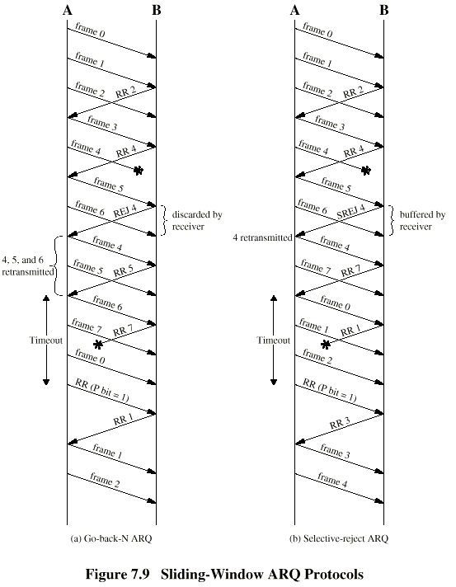
Go-Back-N
Diagram
Remark:
RR(P bit = 1) is a special RR which is used by the source to ask for instructions.
For a k-bit sequence number, the window size can be at most 2^{k}-1, otherwise RR 0 is ambiguous (e.g., first sends frame 0 and gets back an RR1, and then sends frames 1,…,7,0, and gets another RR1).

Slide 33
Selective-Reject ARQ
Also called selective repeat
Pros:
  Only rejected frames are retransmitted
  Subsequent frames are accepted by the receiver and buffered
  Minimizes the amount of retransmissions
Cons:
  Receiver must maintain large enough buffer, and must contain logic for reinserting the retransmitted frame in the proper sequence
  Also more complex logic in the source

Slide 34
Selective Reject -
Diagram
Remark:
For a k-bit sequence number, the window size can be at most 2^{k-1,} because the sending and receiving windows overlap.
Assume k=3, and window size is 5.
1. A sends frames 0, 1, …, 4 to B.
2. B receives all 5 frames, and cumulatively acknowledges with RR5.
3. RR5 is lost.
4. A times out, and retransmits frame 0.
5. B is expecting a new set of frames 5, 6, 7, 0, 1. So it will accept the retransmitted frame 0 and regard it as a new frame, which is wrong.

